Slide 1
Animating Web Graphics Using Adobe Edge

Slide 2
1. Setting up your project
Create a new folder on your desktop
Call it [YOURNAME]infographic
INSIDE THAT FOLDER, create another folder
  Name that folder “images”
  Copy the scale and person png files into the images folder
Open Edge Animate.
Click CREATE NEW.
Notes:
Note: make sure that you get your students to download & install Adobe Edge ANIMATE. There is Edge Code, Edge Reflow, Edge Fonts, etc.

Slide 3
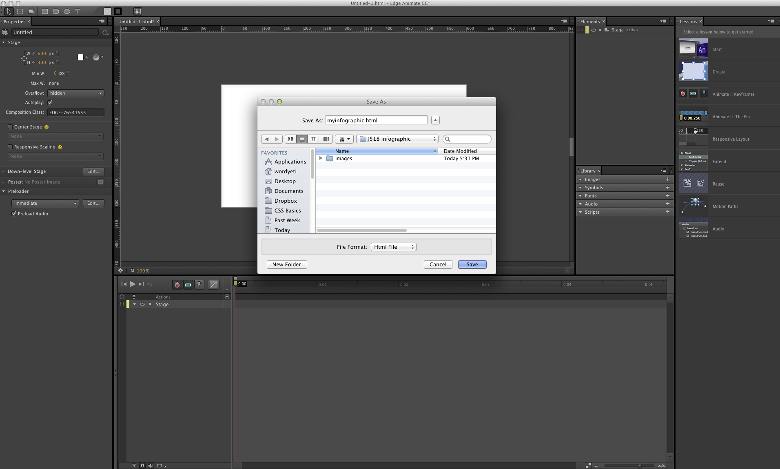
2. Create new project. Save in folder
Notes:
I have found that there is often confusion when it comes to the concept of keeping all files in the same folder, and then using FTP to upload that folder to a webserver. This step may require some explanation.

Slide 4
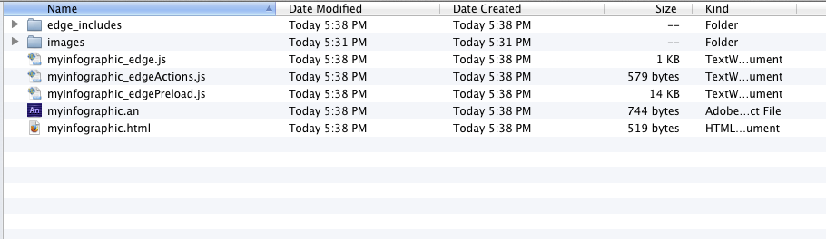
3. Check your folder.
You should see a whole bunch of new files.
Note the .js file extension.
The .an is the Edge Animate file
Notes:
This is one of a series of “check-in” slides to get the students to look at what they’ve done, and see if what they’ve got on their computers looks like what you’ve got on yours.

Slide 5
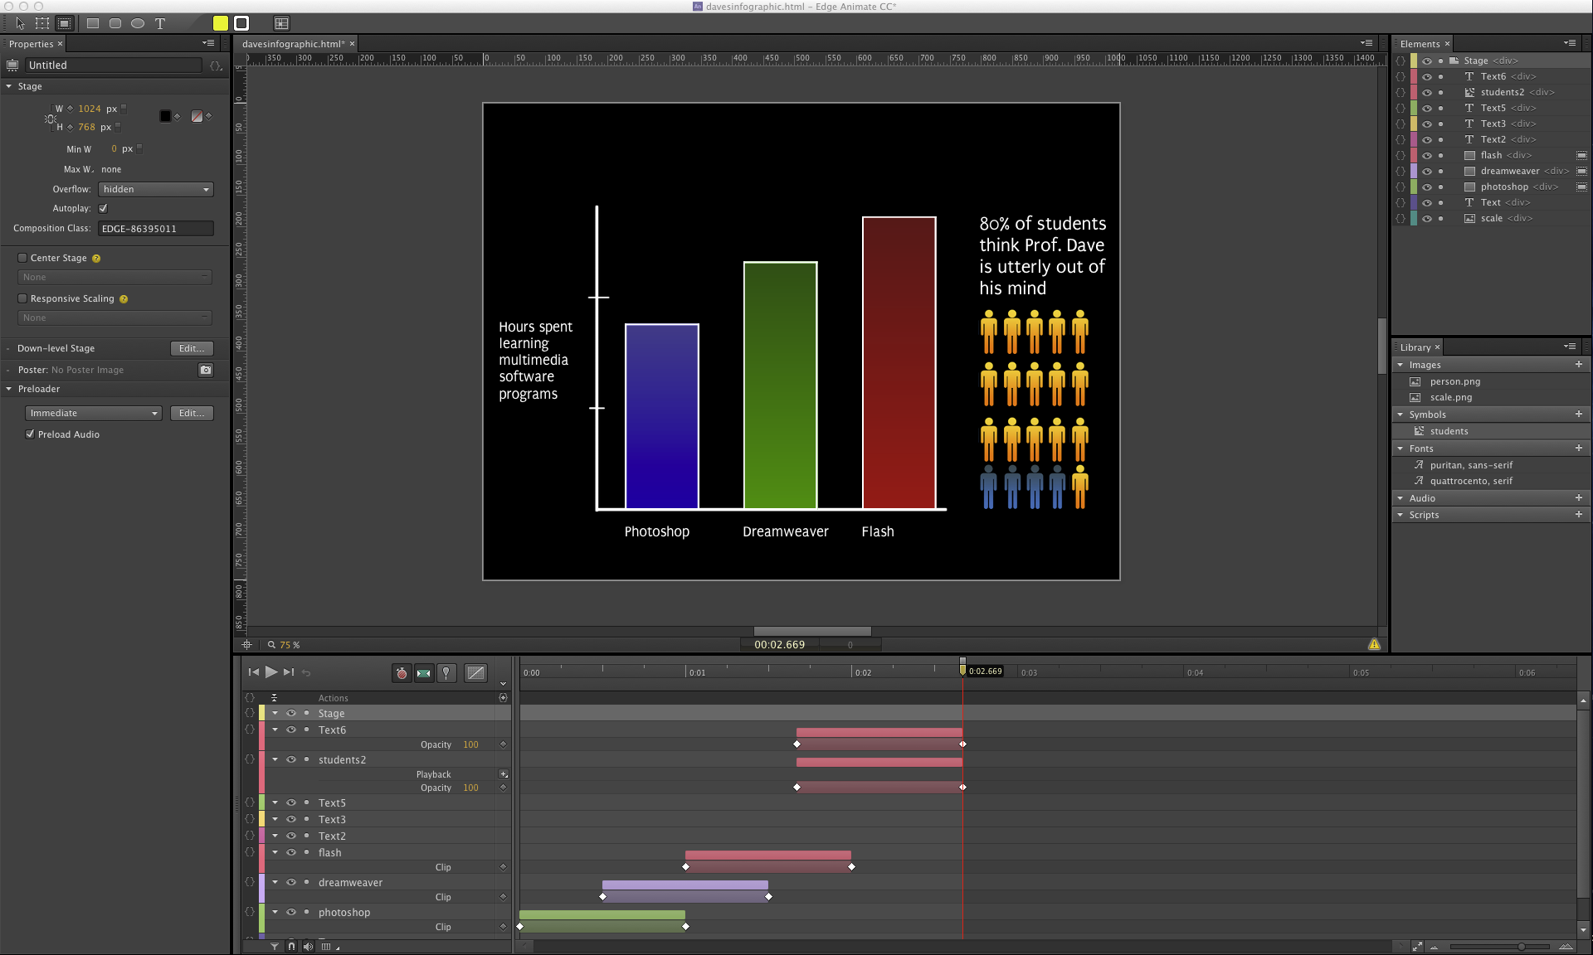
A brief explanation of the interface
Properties
Stage
Timeline
Library
Notes:
It helps to compare the UI for Edge to the workspaces they are familiar with in Premiere. Timeline at the bottom, window above where you see stuff happen as you scrub the playhead around.

Slide 6
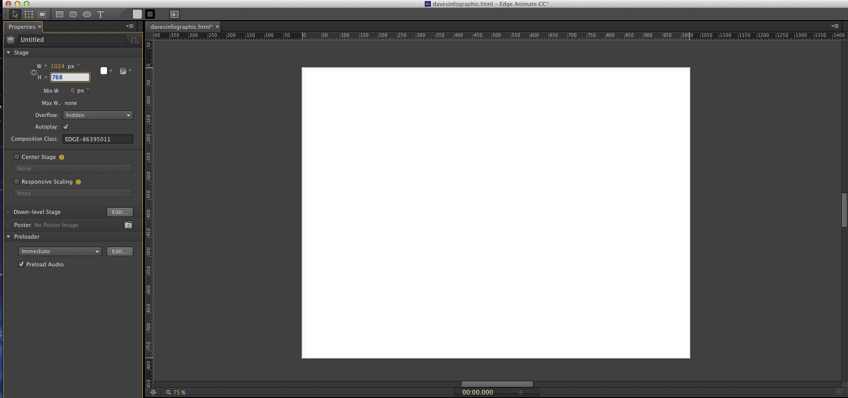
4. Set size to 1024 x 768
You may need to zoom out to see everything
Notes:
Depending on whether they have computers with Retina displays, the stage may be a bit too small to show the entire window.

Slide 7
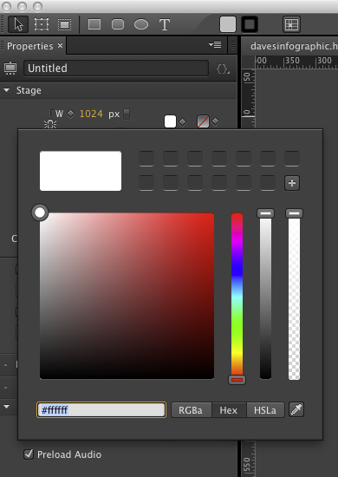
5. Set color swatches
Pick colors you like for your bar charts
Drag the circle around and then click on the plus sign to fill in the boxes with the color you want to use
Notes:
This is kind of a find step. You might also send them to Adobe Kuler to check out color schemes.

Slide 8
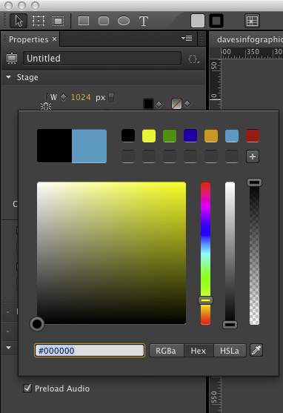
Make sure that at least one of the colors is black.
Notes:
It really doesn’t matter how many colors they put as swatches.

Slide 9
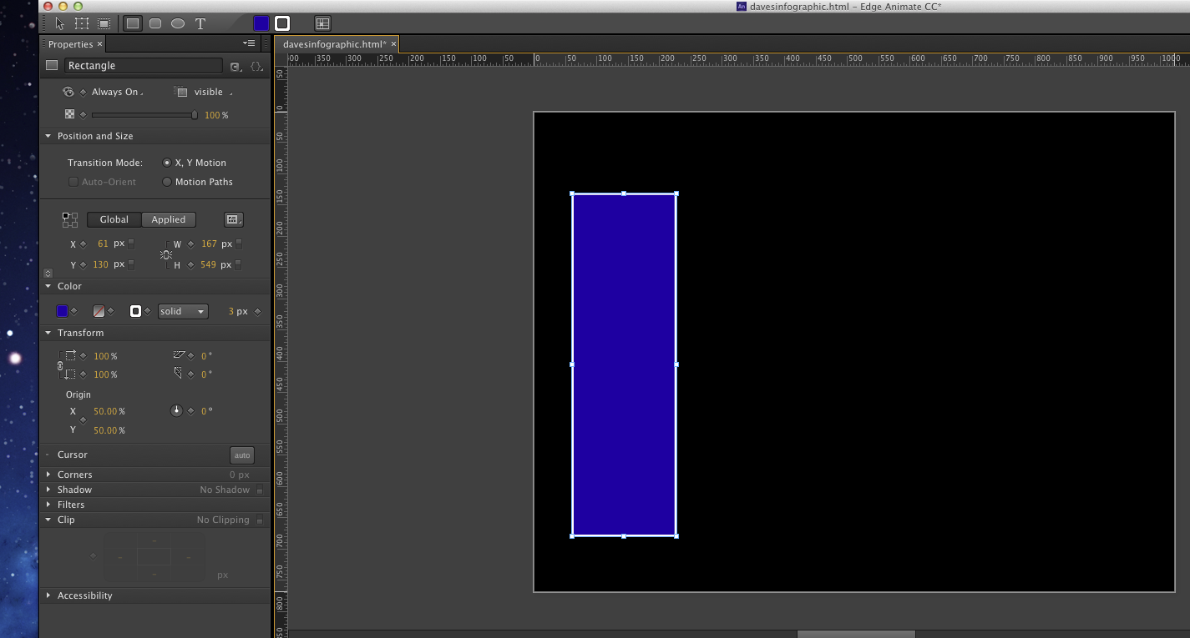
6. Draw a rectangle
Click on the rectangle tool in the upper left – or hit keyboard shortcut “M”
Then click on the left little box under “Color” and choose a color
Notes:
Click and drag to draw a rectangle. You can also show off how to draw circles or rectangles with rounded corners.

Slide 10
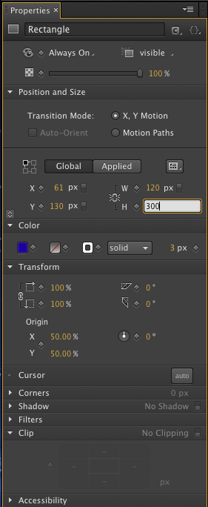
7. Adjust height & width
You can also click and drag it around on the stage
-OR-
Adjust the position using the X and Y coordinates
You can also play with gradients – it’s the box next to the color box.
Next to it is the “border-color” box. You can choose to have an outline around your bar and also the thickness of that border. I chose white, solid & 3px.

Slide 11
8. Import scale and person pngs
File → Import. Navigate to the images folder. Select scale and person. Click OK.
These will show up in your Library panel, under “Images”. Drag the scale graphic to wherever you want it on your stage.
(I suggest leaving yourself room on the left and underneath so you can write the legend for your graph.)
Drag your rectangle until it sits flush with the bottom line of your graph.
Notes:
I created the scale in Photoshop. If you have time, you might consider this as separate lesson.

Slide 12
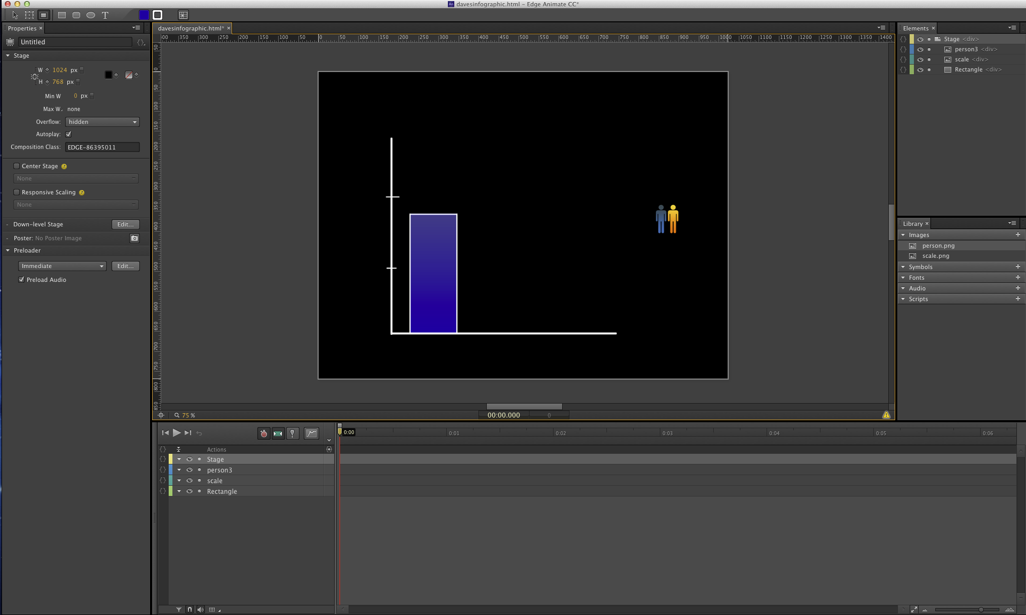
Reality check: does it look like this?

Slide 13
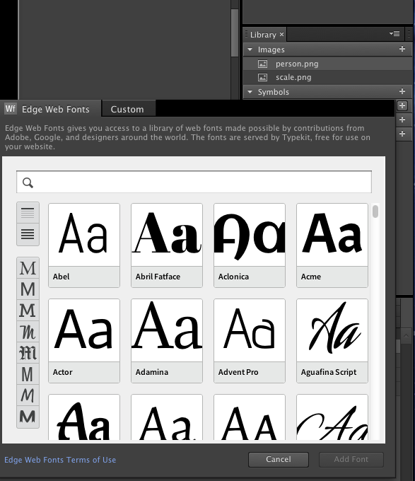
9. Let’s add some web fonts
Click the plus sign ( + ) next to Fonts.
A panel will open up with all the Adobe Edge fonts you can use.
You can also add Google fonts, Fontsquirrel, etc. But that’s kind of a pain, so we’re not going to mess with it right now.
Don’t go totally crazy. We don’t need a ransom note look. Pick two, and hit “Add font.”

Slide 14
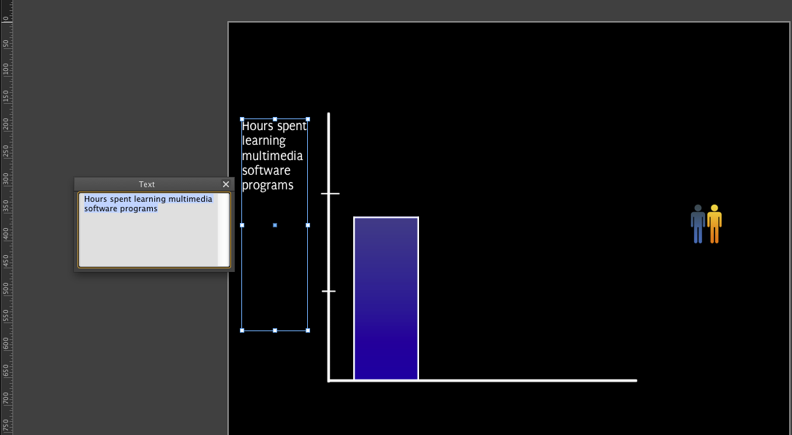
10. Write something
Click on the Text tool (keyboard shortcut “T”). Click and drag on the stage to create a text box. Another little box will open up next to it.
Type in what you are measuring in your graph.
If nothing appears – you have your text color set to black.
Notes:
Again, a lot of students start freaking out when they’re typing an nothing appears. Get them to change the text color.

Slide 15
11. Now get creative
Draw another rectangle.
Make it another color.
Make it a different size.
Write a caption going across the bottom of the screen
Notes:
Give students some time to try their hand and drawing. Some will already be way ahead at this step.

Slide 16
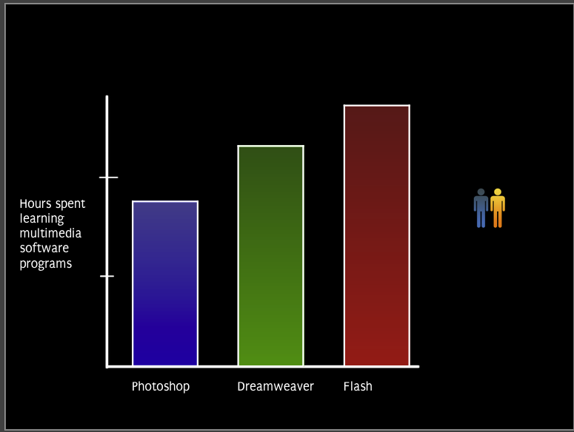
Reality Check

Slide 17

12. Time to clip and clone
Click on the clipping tool (keyboard shortcut “C”).
Click on the person on the stage. A green box appears around them. Click on the left side and drag over to erase the little blue guy.
Notes:
Might be a good place to talk about “instances” and what those mean in web graphics programs – that by having only one image, this saves time/effort, and yet allows them flexibility in their designs.

Slide 18
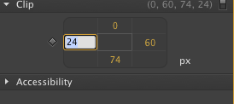
13. Get precise about it.
Over on the bottom of the left side is the Clip panel. Click on the number on the left and type in “30”
This will clip away the blue person. Hit return.
Click and drag another person.png to the stage. Repeat the process (only clipping from the right this time) to create only a little blue person.
Notes:
If they’ve been working in Dreamweaver, this numbered panel will look familiar to them.

Slide 19
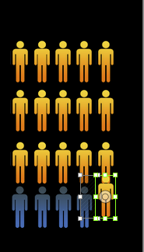
14. Clone the people
Hold down the option key. Click on a person. Drag them around. Release, and you have cloned that person.
Arrange them in order. Guidelines in Edge will help.

Slide 20
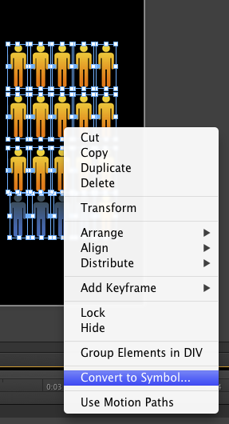
15. Turn people into symbols
Click and drag on the stage to select all your people. Then right-click (Opt+click) and choose Convert to Symbol…
Name your symbol “students”

Slide 21
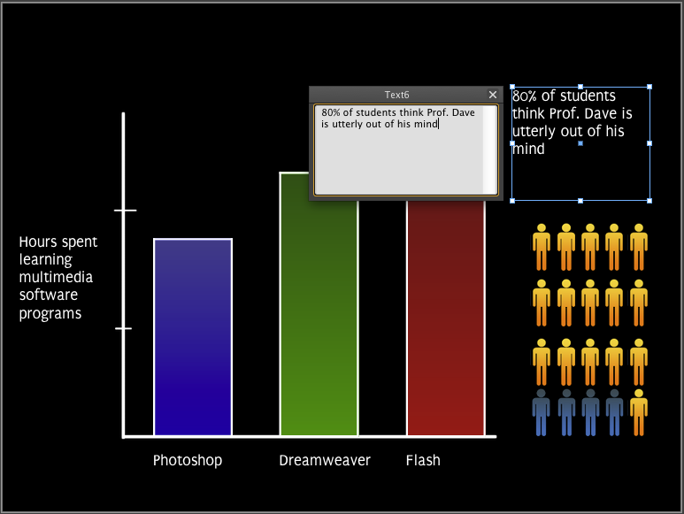
16. Write another caption

Slide 22
Ready to animate?

Slide 23
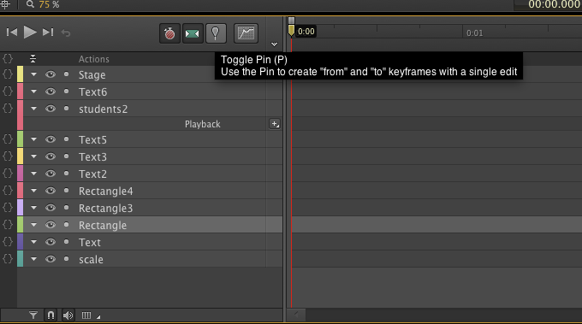
Down on the timeline, click on the Toggle Pin (or hit “P”).
This will turn on animation. A little blue pin will appear above the playhead at 0:00
Drag it to the right about 1 second. A blue line will appear above the timeline.
Notes:
Make sure they have the playhead set to 0:00 before they invoke the Toggle Pin.

Slide 24
17. Animate the first bar.
Click on the first rectangle.
Click on our old friend “Clipping tool.”
Click on the top of the rectangle, and drag downwards until the rectangle disappears.
Repeat for each of the rectangles.
You will see little colored bars with triangles on them appear in the timeline.

Slide 25
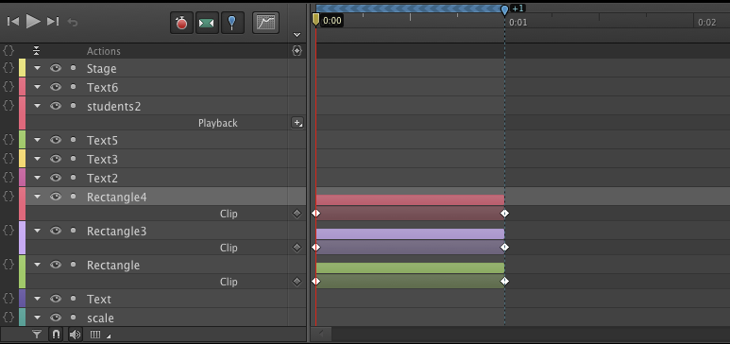

Slide 26
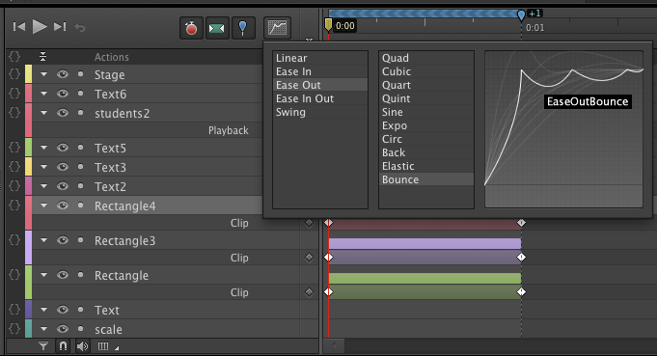
18. Click on the Easing panel
Choose Ease Out Bounce

Slide 27
19. Click on the toggle pin
This will turn off the animation function.
Click on the play button or hit the space bar.
Watch your first animation play!

Slide 28
20. Stagger the animations
Click on the bars next to the individual rectangles in the timeline
Drag the animations to the right – maybe a half-second at a time.

Slide 29
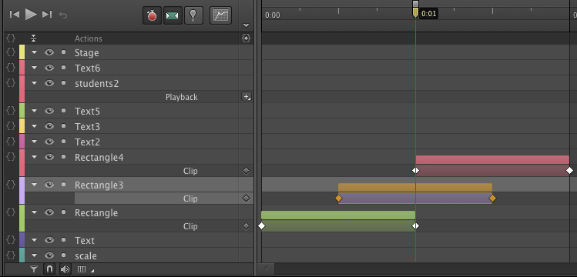

Slide 30
21. Fade in students and text
Click on the students symbol.
Click on the toggle pin and drag out about 1 second
Up in the left corner, click on Opacity, and drag it down to 0%

Slide 31
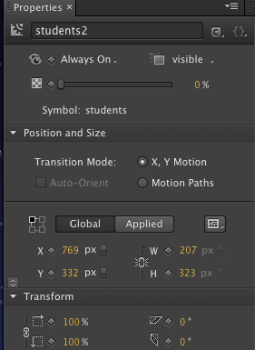

Slide 32
22. Repeat for the text box
Turn off the toggle pin.
Click and drag the layers further to the right, so that the timing is such that the animations take place as the other animations are ending.

Slide 33
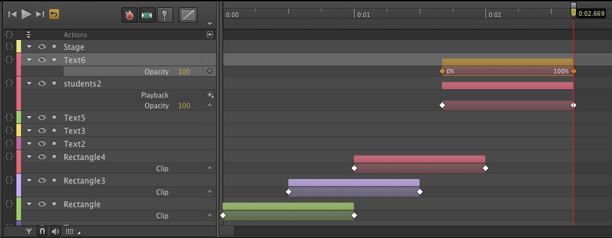
Play your animation again
Notes:
Hopefully, you will hear chirps of joy here.

Slide 34
23. Publish your animation
File →Publish settings
Web will give you a folder that you can FTP to a website.
Animate deployment package gives you something you can import into Dreamweaver.
iBooks/OSX gives you something you can put in an iBook – or turn into an OSX widget.

Slide 35
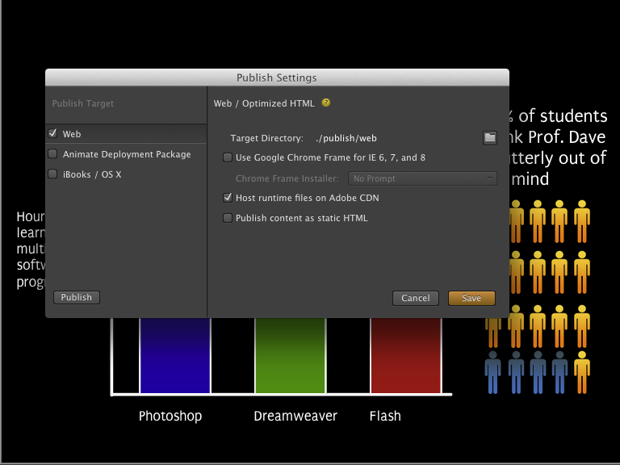

Slide 36
Next week’s assignment
Create an animated infographic, using some of the data that you found for this week.
You can create your own images – or you can find images on the web.
Upload the folder with your creation to the ASCJweb.com shared server space.
Resources: Lynda.com videos on Edgehttp://www.lynda.com/Edge-Animate-tutorials/Edge-Animate-Essential-Training/108880-2.html

